Slide 1


Slide 2
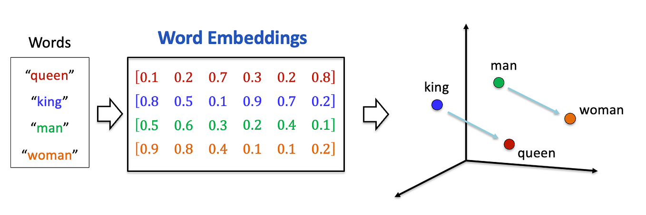

Slide 3
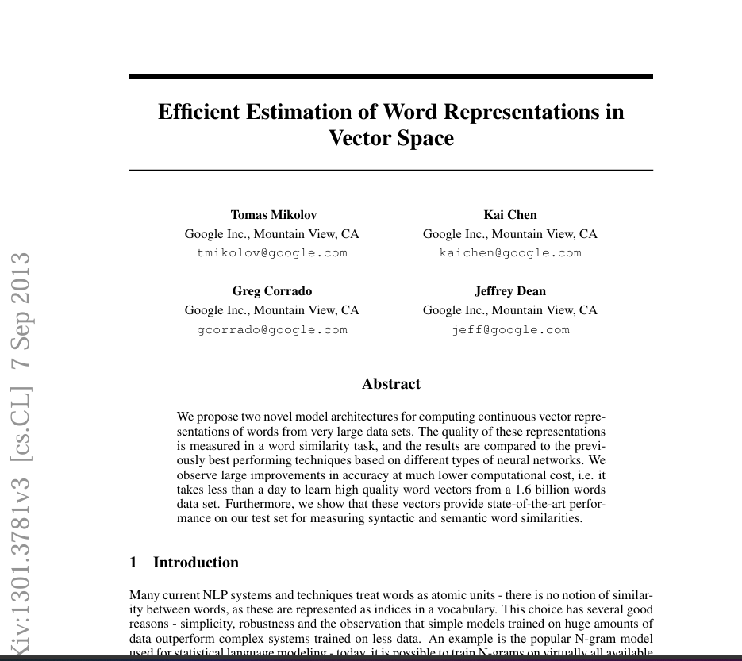


Slide 4

The Problem
Computers cannot understand words directly. They need numbers.
“I love cats”
“I love dogs”
Problem:
According to one-hot vectors, cat is not more similar to dog than to apple.
All different words are treated as equally unrelated.
Using One-Hot Encoding
Vocabulary | cat | dog | apple | mango
cat | 1 | 0 | 0 | 0
dog | 0 | 1 | 0 | 0
apple | 0 | 0 | 1 | 0
mango | 0 | 0 | 0 | 1

Slide 5
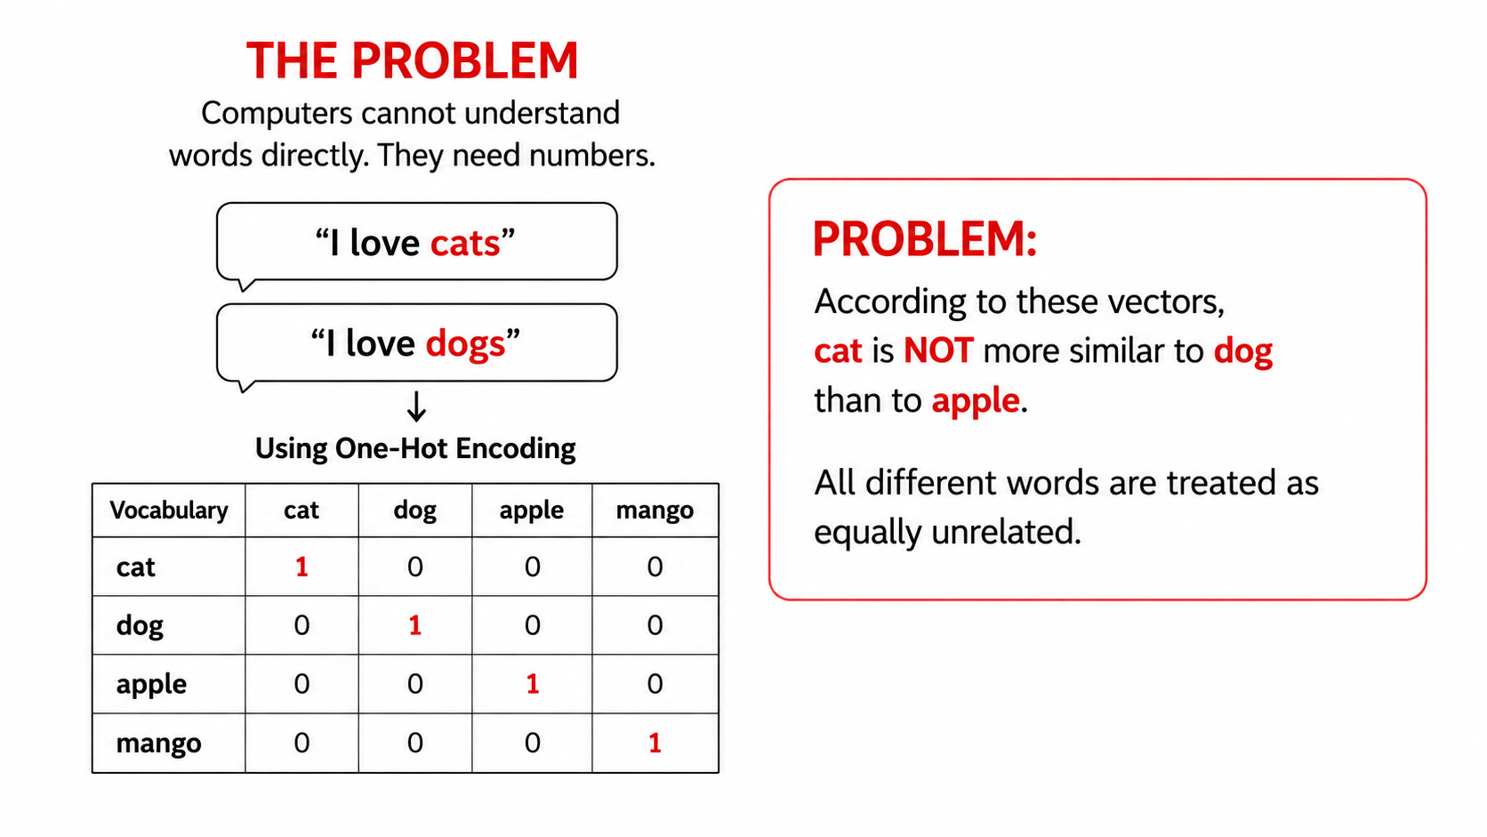

Slide 6
Why We Need Word2Vec
Words that appear in similar contexts tend to have similar meanings.
What is Word2Vec?
Word | Vector Representation
cat | [ 0.81, 0.72, 0.15, ... ]
dog | [ 0.79, 0.70, 0.18, ... ]
apple | [ -0.21, 0.13, 0.91, ... ]
mango | [ -0.22, 0.11, 0.92, ... ]
I have a pet cat.
I have a pet dog. cat ≈ dog
I eat a red apple.
I eat a ripe mango. apple ≈ mango
Benefits:
• similar words have similar vectors
• captures meaning and relationships
• dense vectors are efficient
• useful for many NLP tasks
Idea: if two words occur in similar contexts, they should have similar vector representations.

Slide 7
Intuitive View of Embedding Dimensions
Illustrative dimensions only: real Word2Vec dimensions are latent, not manually named.
 | battle | horse | king | man | queen | ... | woman
authority
event
has tail?
rich
gender

Slide 8
Illustrative Semantic Dimensions
This slide is a teaching analogy, not real Word2Vec internal dimensions.
 | battle | horse | king | man | queen | ... | woman
authority | 0 | 0.01 | 1 | 0.2 | 1 | ... | 0.2
event | 1 | 0 | 0 | 0 | 0 | ... | 0
has tail? | 0 | 1 | 0 | 0 | 0 | ... | 0
rich | 0 | 0.1 | 1 | 0.3 | 1 | ... | 0.2
gender | 0 | 1 | −1 | −1 | 1 | ... | 1
king − man + woman ≈ queen
king | man | woman | result
[1,0,0,1,−1] | [0.2,0,0,0.3,−1] | [0.2,0,0,0.2,1] | [1.0,0,0,0.9,1]

Slide 9
Sparse Vector vs Dense Vector
Sparse vector
Dense vector
One-Hot / Bag-of-Words
• very high dimensional
• mostly zeros
• does not capture similarity
Word2Vec / GloVe / FastText
• lower dimensional
• few or no exact zeros
• captures similarity and relationships
 | cat | dog | apple | mango | king | queen
cat | 1 | 0 | 0 | 0 | 0 | 0
dog | 0 | 1 | 0 | 0 | 0 | 0
apple | 0 | 0 | 1 | 0 | 0 | 0
king | 0 | 0 | 0 | 0 | 1 | 0
Word | d1 | d2 | d3 | d4 | d5
cat | 0.82 | −0.31 | 0.45 | 0.12 | −0.77
dog | 0.79 | −0.28 | 0.49 | 0.10 | −0.72
apple | −0.21 | 0.63 | −0.31 | 0.78 | 0.12
king | 0.51 | 0.24 | −0.61 | 0.35 | −0.10
Vector dimension = 6 → 83.3% zeros in this toy example
Vector dimension = 5 → all values carry information

Slide 10
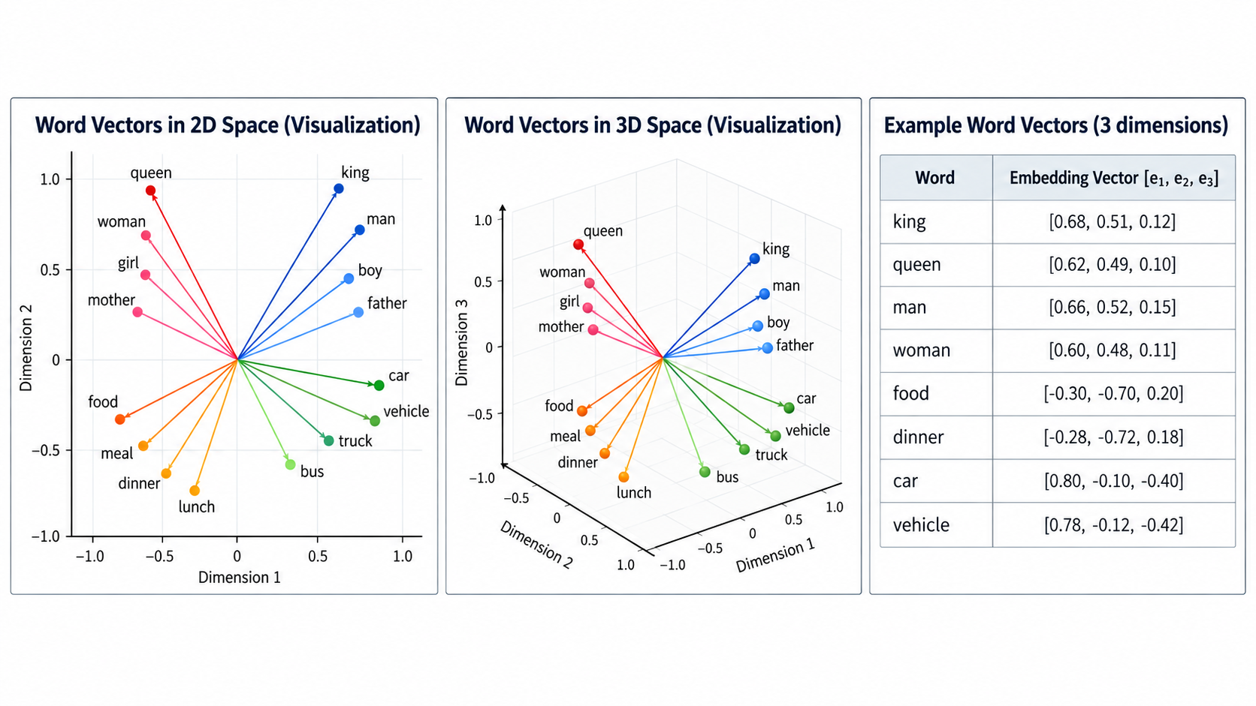

Slide 11
Word Vectors in Space
2D/3D visualization
Example word vectors
queen king
woman man
food dinner
meal lunch
car vehicle
truck bus
Word | [e1, e2, e3]
king | [0.68, 0.51, 0.12]
queen | [0.62, 0.49, 0.10]
man | [0.66, 0.52, 0.15]
woman | [0.60, 0.48, 0.11]
food | [−0.30, −0.70, 0.20]
dinner | [−0.28, −0.72, 0.18]
car | [0.80, −0.10, −0.40]
vehicle | [0.78, −0.12, −0.42]
Similar words appear near each other after training.

Slide 12
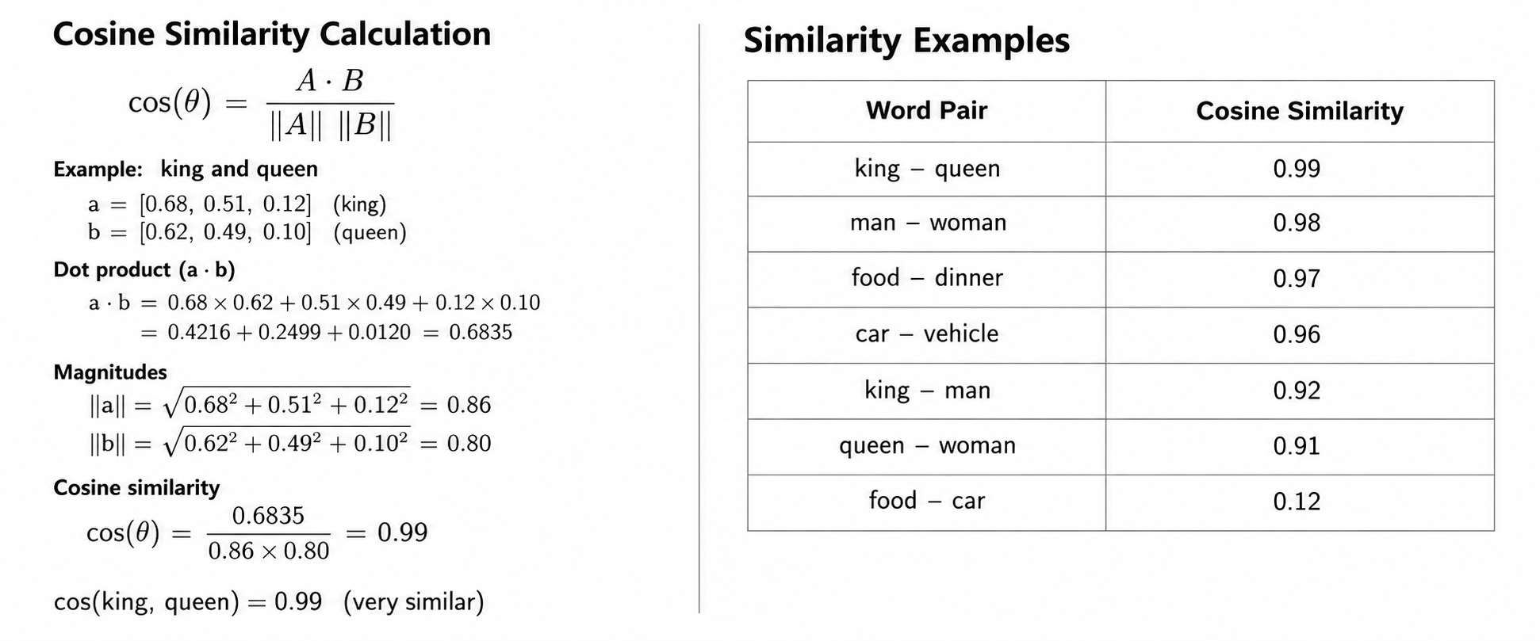

Slide 13
Types of Word2Vec
Word2Vec has two main architectures for learning word embeddings from text.
Continuous Bag of Words (CBOW)
Skip-gram
Predicts the target word from its surrounding context words.
Predicts surrounding context words from a given target word.
Key points:
• uses surrounding words to predict the center word
• faster training compared to Skip-gram
• works well for frequent words
Key points:
• uses the center word to predict surrounding words
• generally slower than CBOW
• often works well for rare words

Slide 14
Move to Actual Training and Math
Prepare data for CBOW training: Tokenization → Vocabulary → Input-Target Pairs
Text Data (24 tokens)
Tokenization (24 tokens)
Unique Vocabulary
(15 words)
the quick brown fox jumps
over the lazy dog and the fox
runs into the forest and the
dog follows the fox quickly .
['the','quick','brown','fox',
'jumps','over','the','lazy',
'dog','and','the','fox','runs',
'into','the','forest','and',
'the','dog','follows','the',
'fox','quickly','.']
Index | Word | Index | Word
0 | the | 8 | and
1 | quick | 9 | runs
2 | brown | 10 | into
3 | fox | 11 | forest
4 | jumps | 12 | follows
5 | over | 13 | quickly
6 | lazy | 14 | .
7 | dog
Total tokens = 24
Total tokens = 24
Vocabulary size V = 15

Slide 15
CBOW Training Data Preparation (Window Size = 2)
For each target position, use two words on the left and two words on the right as context.
Position | Context words | Target
2 | [the, brown, fox, jumps] | quick
3 | [the, quick, fox, jumps] | brown
4 | [quick, brown, jumps, over] | fox
5 | [brown, fox, over, the] | jumps
6 | [fox, jumps, the, lazy] | over
7 | [jumps, over, lazy, dog] | the
8 | [over, the, dog, and] | lazy
9 | [the, lazy, and, the] | dog
10 | [lazy, dog, the, fox] | and
11 | [dog, and, fox, runs] | the
12 | [and, the, runs, into] | fox
13 | [the, fox, into, the] | runs
14 | [fox, runs, the, forest] | into
15 | [runs, into, forest, and] | the
16 | [into, the, and, the] | forest
17 | [the, forest, the, dog] | and
18 | [forest, and, dog, follows] | the
19 | [and, the, follows, the] | dog
20 | [the, dog, the, fox] | follows
21 | [dog, follows, fox, quickly] | the
Total full-window training pairs = 20. First two and last two positions are skipped.

Slide 16
CBOW: Input Context Words and Target Word
Window size = 2
the quick brown [ fox ] jumps over the lazy
Left context words
quick, brown
Target word
fox
Right context words
jumps, over
Input context words (4)
quick
brown
jumps
over
Word indices
quick → 1
brown → 2
jumps → 4
over → 5
Target word (1)
fox → 3
Input context word indices = [1, 2, 4, 5] Target word index = 3

Slide 17
Embedding Lookup
Input embedding matrix E (V = 15, D = 5)
Index | Word | e1 | e2 | e3 | e4 | e5
0 | the | 0.12 | −0.34 | 0.56 | 0.01 | −0.23
1 | quick | −0.21 | 0.37 | −0.11 | 0.44 | 0.18
2 | brown | 0.09 | −0.27 | 0.31 | −0.36 | 0.22
3 | fox | −0.13 | 0.48 | −0.20 | 0.17 | −0.09
4 | jumps | 0.25 | −0.16 | 0.42 | 0.33 | −0.28
5 | over | −0.32 | 0.11 | −0.45 | 0.26 | 0.37
6 | lazy | 0.14 | −0.08 | 0.23 | −0.19 | 0.05
7 | dog | −0.41 | 0.29 | −0.37 | 0.12 | 0.31
8 | and | 0.33 | −0.22 | 0.18 | 0.21 | −0.14
9 | runs | −0.27 | 0.46 | −0.15 | −0.09 | 0.24
10 | into | 0.07 | −0.31 | 0.40 | 0.08 | −0.36
11 | forest | −0.19 | 0.12 | −0.28 | 0.35 | 0.20
12 | follows | 0.31 | −0.05 | 0.06 | −0.25 | 0.44
13 | quickly | −0.38 | 0.28 | −0.33 | 0.16 | −0.11
14 | . | 0.20 | −0.17 | 0.29 | −0.42 | 0.15
E ∈ R^(15×5)

Slide 18
Embedding Lookup for the 4 Context Words
Context words for target word “fox” with window size = 2:
quick brown [fox] jumps over
Word | Index | Embedding (5 dimensions)
quick | 1 | [ −0.21, 0.37, −0.11, 0.44, 0.18 ]
brown | 2 | [ 0.09, −0.27, 0.31, −0.36, 0.22 ]
jumps | 4 | [ 0.25, −0.16, 0.42, 0.33, −0.28 ]
over | 5 | [ −0.32, 0.11, −0.45, 0.26, 0.37 ]
These four rows are taken from the input embedding matrix E.

Slide 19
After Lookup: 4 Embedding Vectors
Rows correspond to quick, brown, jumps, over.
 | e1 | e2 | e3 | e4 | e5
quick | −0.21 | 0.37 | −0.11 | 0.44 | 0.18
brown | 0.09 | −0.27 | 0.31 | −0.36 | 0.22
jumps | 0.25 | −0.16 | 0.42 | 0.33 | −0.28
over | −0.32 | 0.11 | −0.45 | 0.26 | 0.37
E_context ∈ R^(4×5)

Slide 20
Average the 4 Embeddings (CBOW)
Word | Index | Embedding (5 dimensions)
quick | 1 | [ −0.21, 0.37, −0.11, 0.44, 0.18 ]
brown | 2 | [ 0.09, −0.27, 0.31, −0.36, 0.22 ]
jumps | 4 | [ 0.25, −0.16, 0.42, 0.33, −0.28 ]
over | 5 | [ −0.32, 0.11, −0.45, 0.26, 0.37 ]
h = 1/4 (e_quick + e_brown + e_jumps + e_over)
h = 1/4 ([−0.21, 0.37, −0.11, 0.44, 0.18] + [0.09, −0.27, 0.31, −0.36, 0.22] +
[0.25, −0.16, 0.42, 0.33, −0.28] + [−0.32, 0.11, −0.45, 0.26, 0.37])
Averaged context vector h = [−0.0475, 0.0125, 0.0425, 0.1675, 0.1225] shape: 1 × 5

Slide 21
Output Weight Matrix W′ (5 × 15)
Dim | the | quick | brown | fox | jumps | over | lazy | dog | and | runs | into | forest | follows | quickly | .
w′1 | 0.21 | −0.14 | 0.32 | −0.28 | 0.11 | −0.06 | 0.24 | −0.33 | 0.18 | −0.27 | 0.07 | −0.19 | 0.26 | −0.31 | 0.07
w′2 | −0.12 | 0.27 | −0.25 | 0.14 | −0.31 | 0.19 | −0.17 | 0.08 | −0.22 | 0.31 | −0.36 | 0.12 | −0.08 | 0.20 | 0.16
w′3 | 0.05 | −0.31 | 0.17 | 0.29 | −0.09 | −0.27 | 0.11 | −0.15 | 0.36 | −0.04 | 0.28 | −0.32 | 0.13 | −0.21 | −0.24
w′4 | 0.33 | 0.08 | −0.20 | 0.12 | 0.26 | 0.35 | −0.29 | 0.21 | −0.11 | 0.15 | 0.09 | 0.27 | −0.24 | 0.16 | −0.13
w′5 | −0.24 | 0.11 | 0.06 | −0.33 | 0.22 | −0.18 | 0.31 | −0.07 | 0.25 | −0.19 | 0.14 | −0.23 | 0.30 | −0.05 | 0.31
W′ ∈ R^(5×15)

Slide 22
Count Word Frequency in the Corpus
Example corpus
the quick brown fox jumps over the lazy dog and the fox runs into the forest and the dog follows the fox quickly .
Build the unigram distribution
Word | Count f(w) | Probability P(w)=f(w)/Σf(w)
the | 6 | 0.250
fox | 3 | 0.125
dog | 2 | 0.083
and | 2 | 0.083
quick | 1 | 0.042
brown | 1 | 0.042
jumps | 1 | 0.042
over | 1 | 0.042
lazy | 1 | 0.042
runs | 1 | 0.042
into | 1 | 0.042
forest | 1 | 0.042
follows | 1 | 0.042
quickly | 1 | 0.042
. | 1 | 0.042
Total tokens | 24 | 1.000
First count how often each word appears. This frequency table is the starting point for negative sampling.

Slide 23
Raise Counts to 0.75
Negative sampling smooths raw word counts before selecting negative words.
f(w)^0.75
Word | Count f(w) | Smoothed score f(w)^0.75
the | 6 | 3.83
fox | 3 | 2.28
dog | 2 | 1.68
and | 2 | 1.68
quick | 1 | 1.00
brown | 1 | 1.00
jumps | 1 | 1.00
over | 1 | 1.00
lazy | 1 | 1.00
runs | 1 | 1.00
into | 1 | 1.00
forest | 1 | 1.00
follows | 1 | 1.00
quickly | 1 | 1.00
. | 1 | 1.00
Frequent words still get higher scores, but the 0.75 power reduces their dominance.

Slide 24
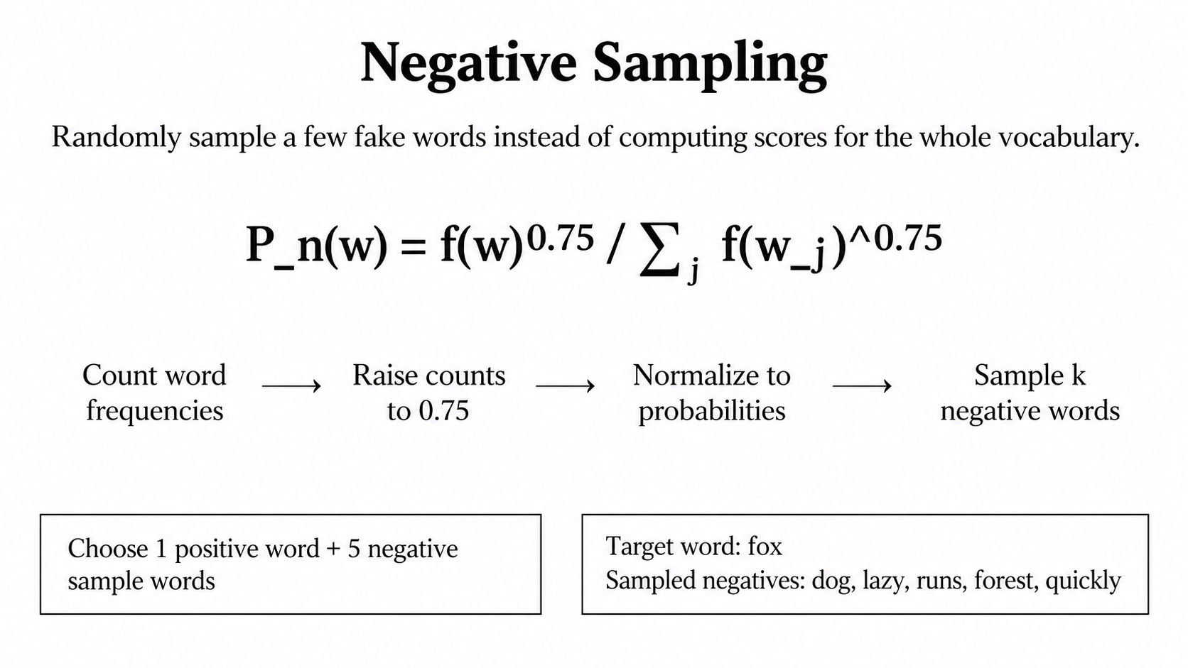

Slide 25
Selected Output Vectors from W′ for Negative Sampling
Choose one positive word and several negative sample words (columns) from the output matrix W′.
Dim | fox (positive) | dog (negative) | lazy (negative) | runs (negative) | forest (negative) | quickly (negative)
w′1 | −0.28 | −0.33 | 0.24 | −0.27 | −0.19 | −0.31
w′2 | 0.14 | 0.08 | −0.17 | 0.31 | 0.12 | 0.20
w′3 | 0.29 | −0.15 | 0.11 | −0.04 | −0.32 | −0.21
w′4 | 0.12 | 0.21 | −0.29 | 0.15 | 0.27 | 0.16
w′5 | −0.33 | −0.07 | 0.31 | −0.19 | −0.23 | −0.05
W′selected ∈ R^(5×6)
For negative sampling, take the positive word and sampled negative words from the output matrix W′.

Slide 26
From Average Vector to Logits and Probabilities
Negative Sampling uses sigmoid, not softmax.
Average context vector
h =
[−0.0475
0.0125
0.0425
0.1675
0.1225]
shape 1×5
Selected output vectors from W′
Logits / Scores
z = hW′selected
Apply sigmoid
σ(x)=1/(1+e^(−x))
Each selected word is treated independently.
Prob.
p=σ(z)
 | fox | dog | lazy | runs | forest | quickly
w′1 | −0.28 | −0.33 | 0.24 | −0.27 | −0.19 | −0.31
w′2 | 0.14 | 0.08 | −0.17 | 0.31 | 0.12 | 0.20
w′3 | 0.29 | −0.15 | 0.11 | −0.04 | −0.32 | −0.21
w′4 | 0.12 | 0.21 | −0.29 | 0.15 | 0.27 | 0.16
w′5 | −0.33 | −0.07 | 0.31 | −0.19 | −0.23 | −0.05
Word | Score
fox | 0.0071
dog | 0.0369
lazy | −0.0195
runs | 0.0169
forest | 0.0140
quickly | 0.0290
Word | p
fox | 0.5018
dog | 0.5092
lazy | 0.4951
runs | 0.5042
forest | 0.5035
quickly | 0.5072
shape 5×6
Use sigmoid for each selected word independently — not softmax over the whole vocabulary.

Slide 27
CBOW with Negative Sampling: Full Process
Context window
quick, brown, [fox], jumps, over
Embedding lookup
quick, brown, jumps, over
Average context
h = [−0.0475, 0.0125, 0.0425, 0.1675, 0.1225]
Negative sampling
fox + 5 negatives
Selected output vectors
fox, dog, lazy, runs, forest, quickly
from W′
Compute scores
z = h W′selected
shape: 1×6
Apply sigmoid
positive → close to 1
negative → close to 0
Negative sampling loss
L = −log σ(z_fox) − Σ log σ(−z_neg)
Which weights update?
Input embedding matrix E:
update only context word rows: quick, brown, jumps, over
Output matrix W′ or U:
update only selected output vectors: fox, dog, lazy, runs, forest, quickly
All other vocabulary words are not updated in this training step.
Training pushes the positive target score up and negative sample scores down.

